Slide 1
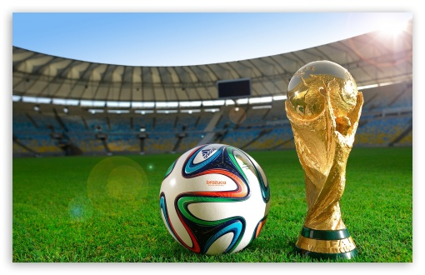
FIFA World Cup Analysis

Slide 2
THE FIFA WORLD CUP
The FIFA World Cup, often simply called the World Cup, is an international association football competition contested by the senior men's national teams of the members of the Fédération International de Football Association (FIFA), the sport's global governing body. The championship has been awarded every four years since the inaugural tournament in 1930, except in 1942 and 1946 when it was not held because of the Second World War. The current champion is Germany, which won its fourth title at the 2014 tournament in Brazil.

Slide 3
CONTENTS
Data Cleaning
Visualization
- Most Number of World Cup Winning Tittle
- Number of Goal Per Country
-Attendance, Number of Teams, Goals, and Matches per Cup
-Goals Per Team Per World Cup
-Matches With Heighest Number Of Attendance
-Stadium with Highest Average Attendance
-Which countries had won the cup ?
-Number of goal per country
-Match outcome by home and away teams

Slide 4
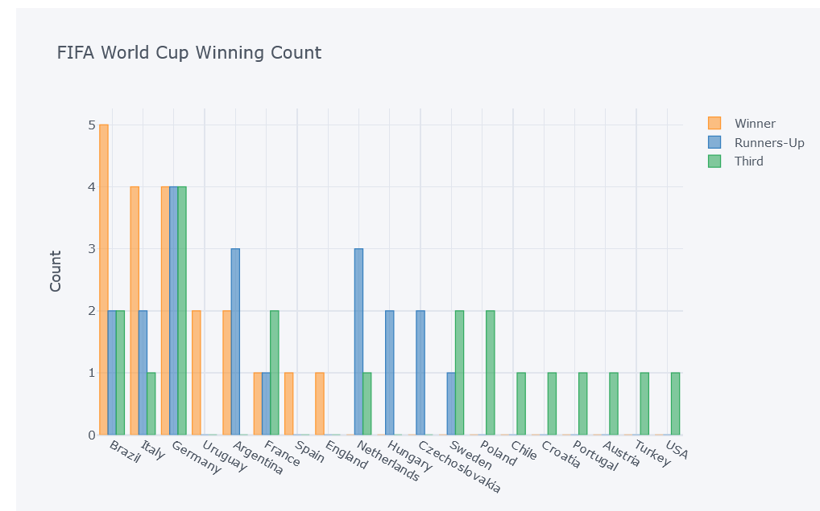
VISUALIZATION

Slide 5
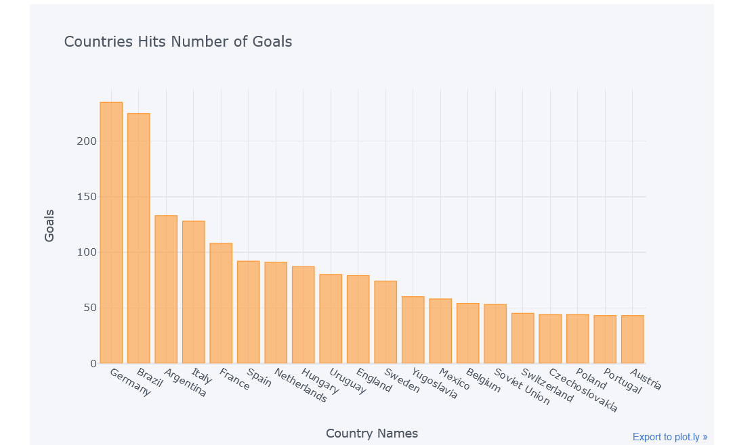
VISUALIZATION

Slide 6
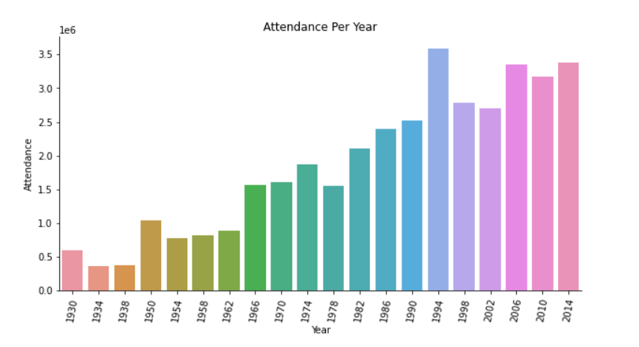
VISUALIZATION

Slide 7
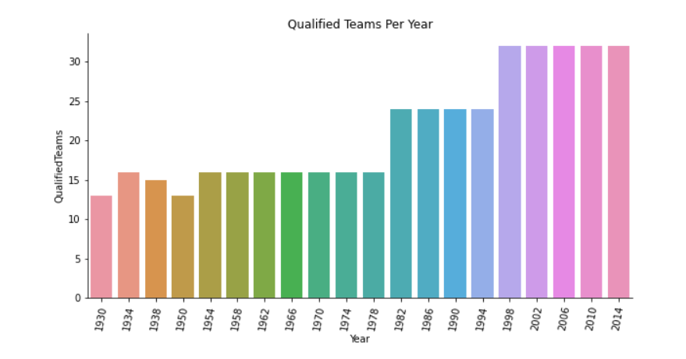
VISUALIZATION

Slide 8
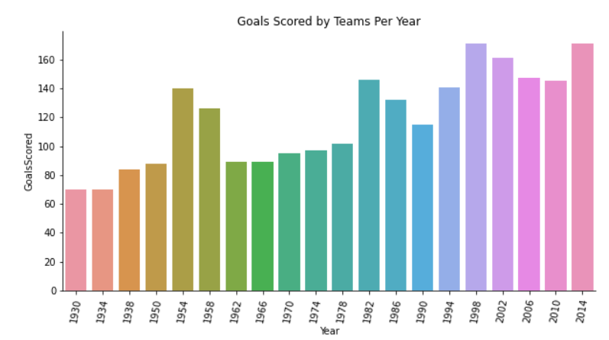
VISUALIZATION

Slide 9
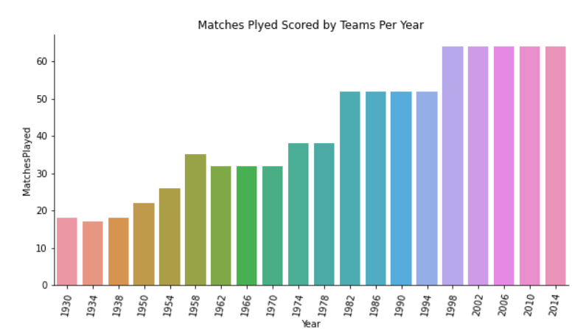
VISUALIZATION

Slide 10
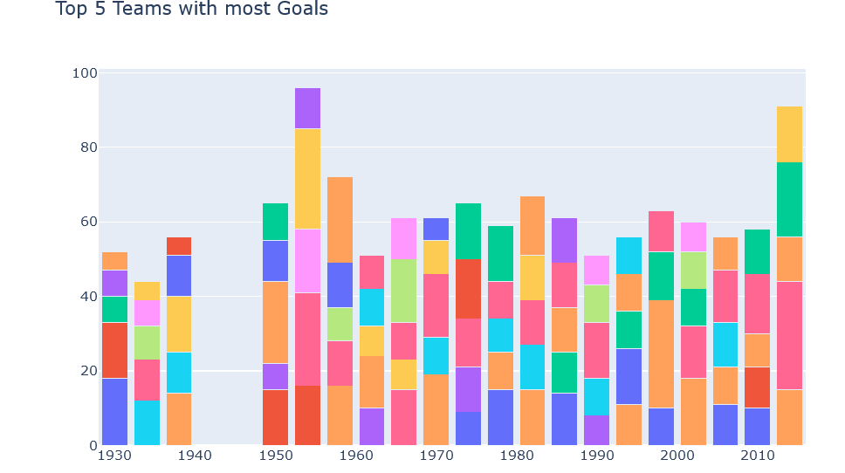
VISUALIZATION

Slide 11
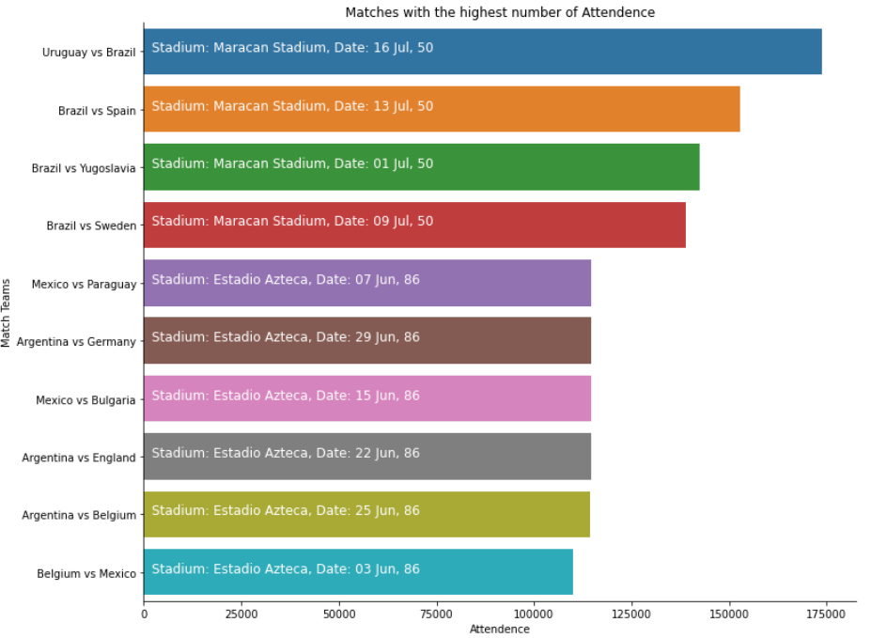
VISUALIZATION

Slide 12
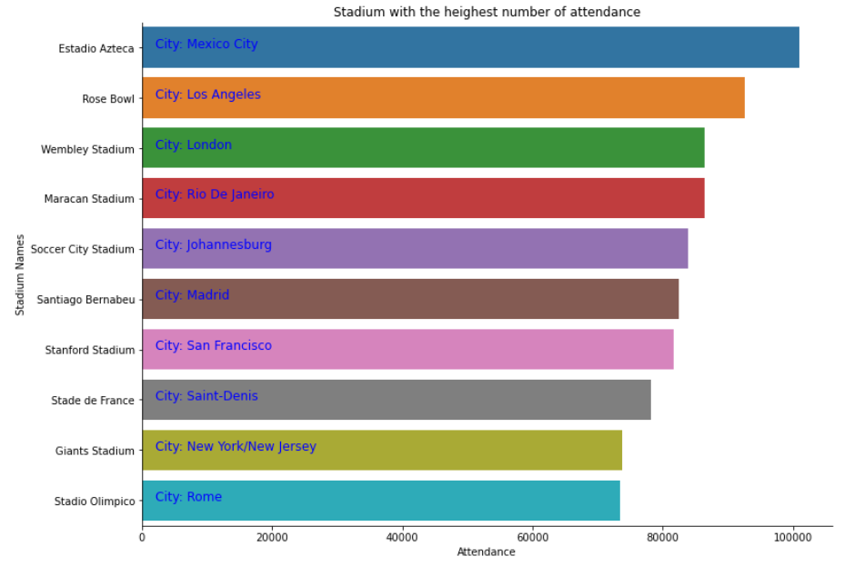
VISUALIZATION

Slide 13
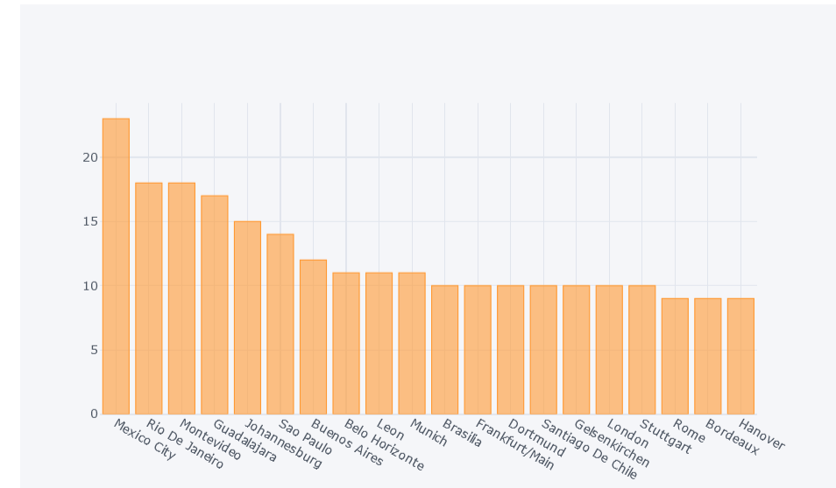
VISUALIZATION

Slide 14
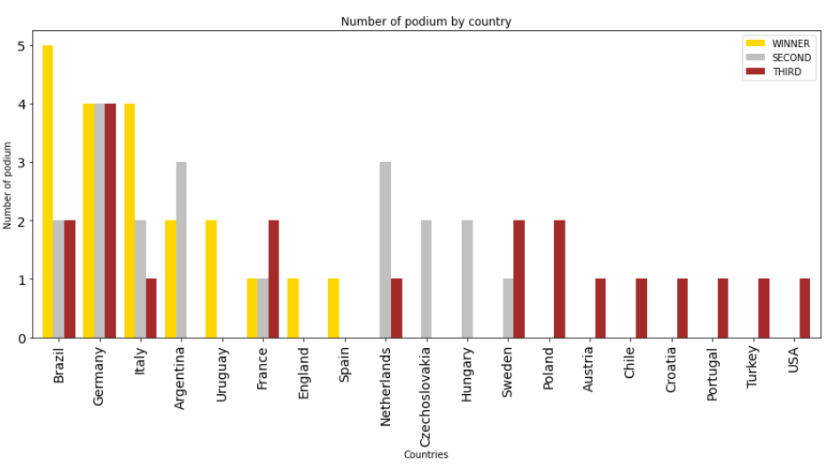
VISUALIZATION

Slide 15
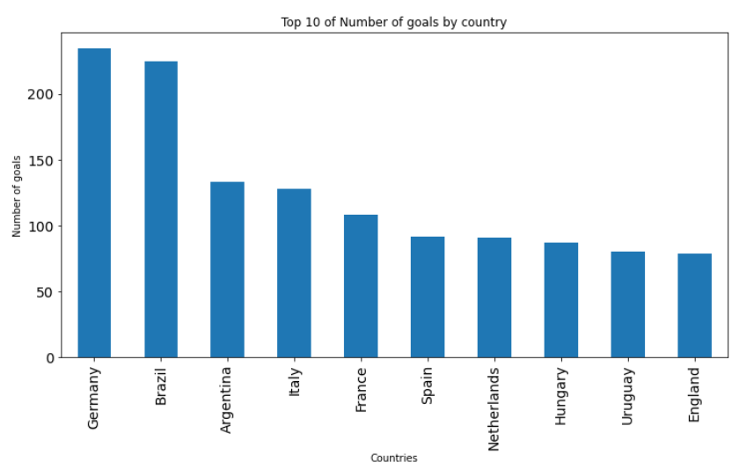
VISUALIZATION

Slide 16
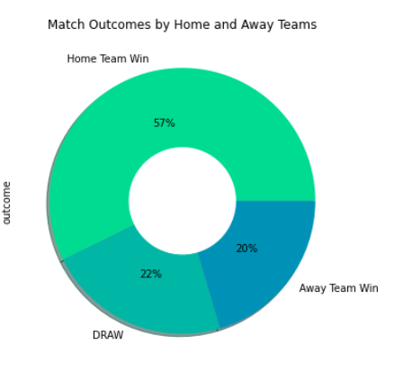
VISUALIZATION

Slide 17
THANK YOU…..
By AYAN KHAN PATHAN

